Slide 2
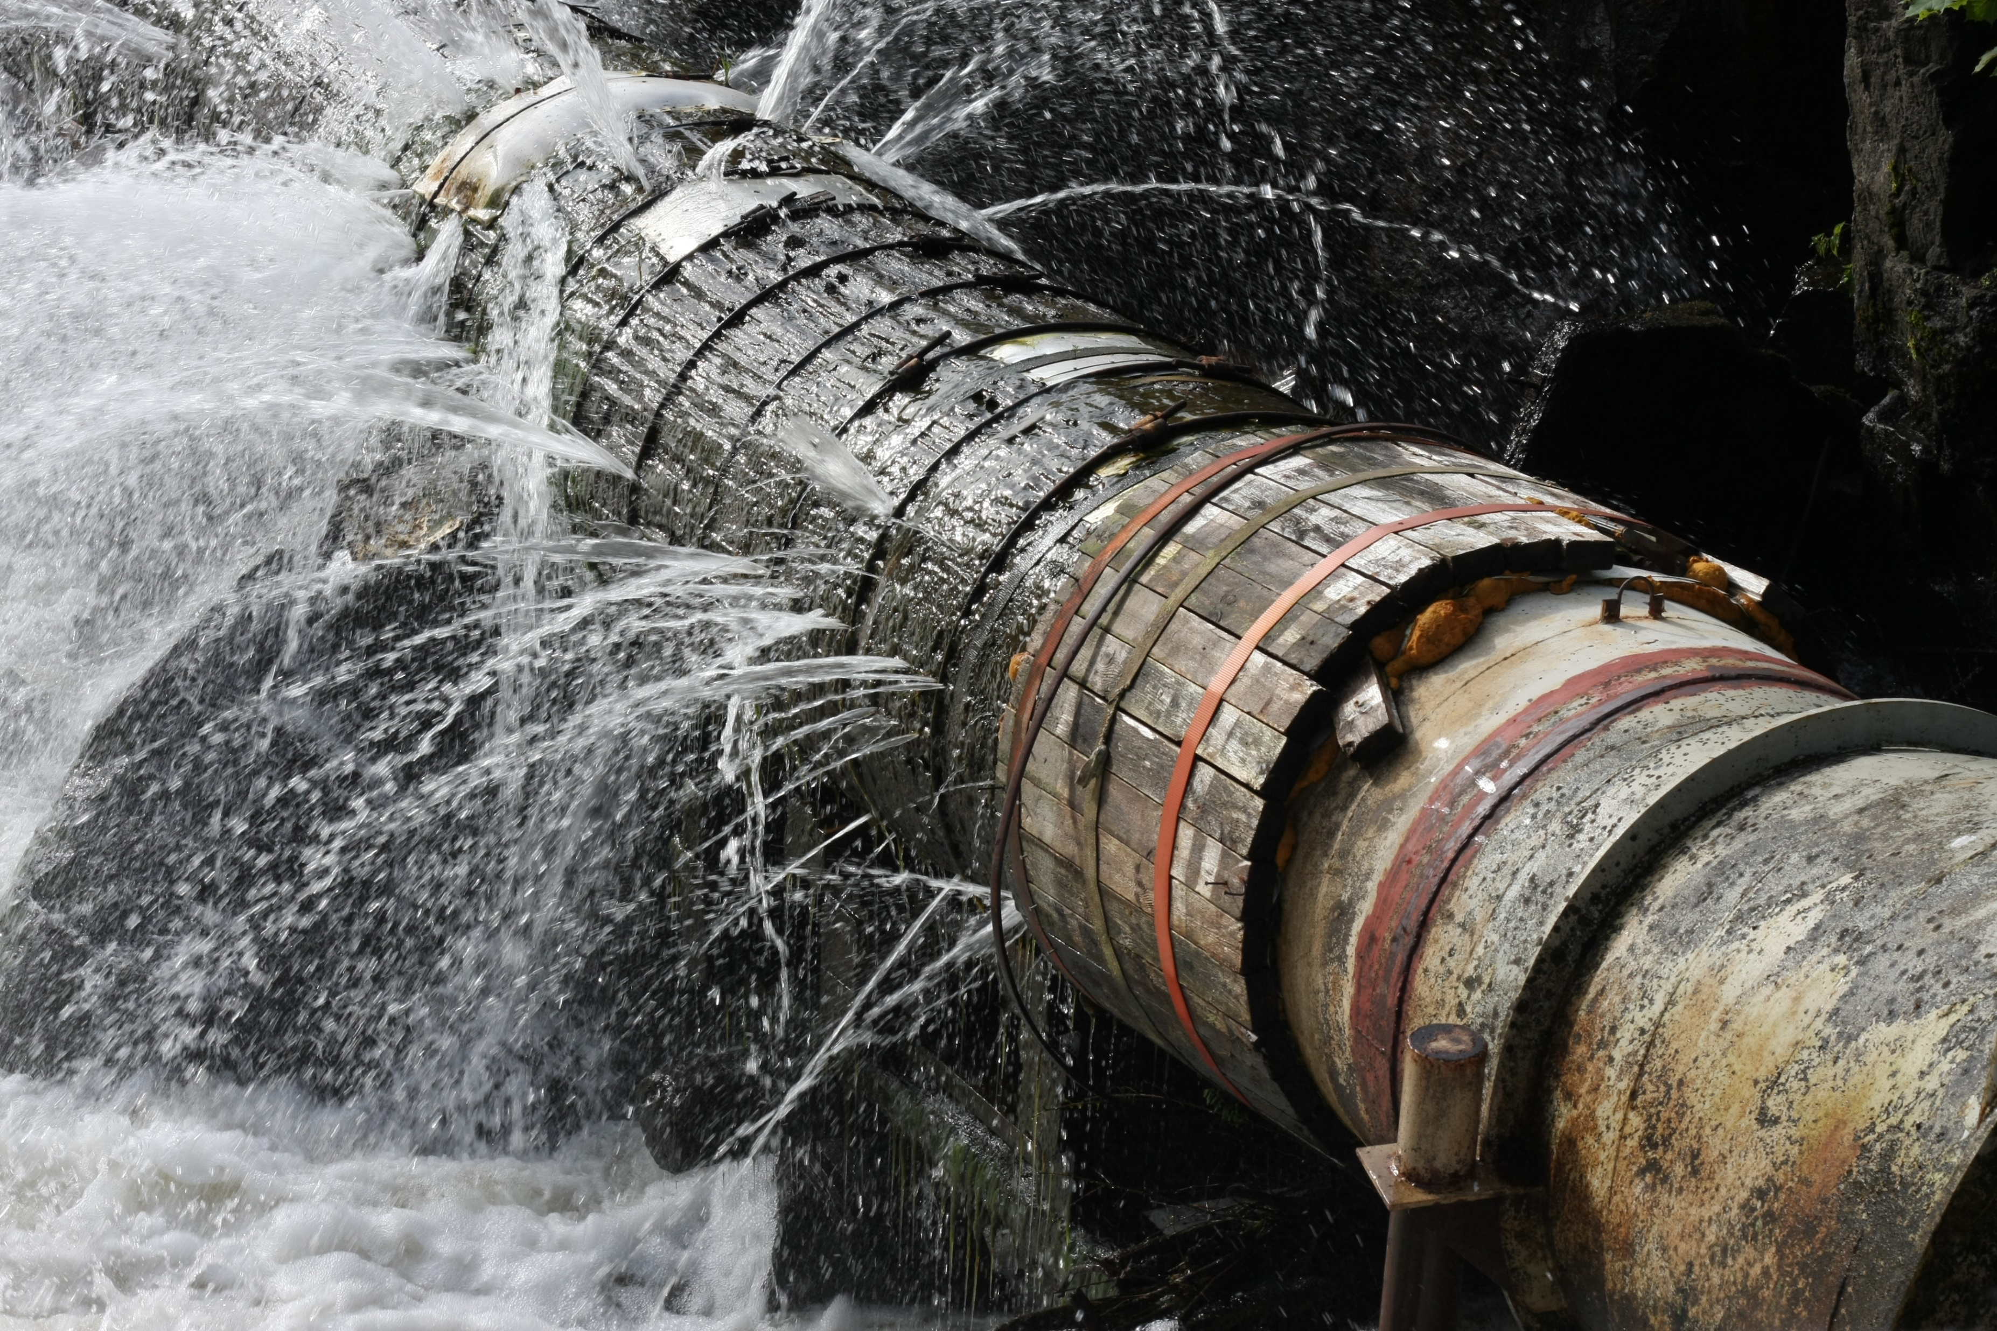
WHERE ARE THE TEACHERS ?
DESIGNING FEDERAL POLICY
FOR TEACHER DEVELOPMENT
stem – cte – cs - stw

Slide 3
High Demand Teacher Initiative
Creating teachers for the 21st Century
Some Data
Some Legislative History
Key Findings
Policy Recommendation
Notes:
The purpose of this briefing is to present a proposal for teachers for the 21st century economy.
From this point on, I will use the word ‘teacher’ to refer solely to those that teach in these fields.
STEM, science, technology, engineering, and math
Career and Technical Education, or CTE
And STW, or Skilled Technical Workforce
The major emphasis is on the secondary grades, high schools, college and career academies, technical high schools, and technical colleges.

Slide 4
High Demand Teacher Initiative
Creating teachers for the 21st Century
Some Data
Some Legislative History
Key Findings
Policy Recommendation
Notes:
The purpose of this briefing is to present a proposal for teachers for the 21st century economy.
From this point on, I will use the word ‘teacher’ to refer solely to those that teach in these fields.
STEM, science, technology, engineering, and math
Career and Technical Education, or CTE
And STW, or Skilled Technical Workforce
The major emphasis is on the secondary grades, high schools, college and career academies, technical high schools, and technical colleges.

Slide 5
High Demand Teacher Initiative
Background
8 years of Investigation, Research, Interviews, Meetings……..
State and Federal Politicians
State Agency Leaders, University Leadership
Deans, Professors, Students
Economic Development Agencies
School Superintendents, Teachers
Policy Researchers
Notes:
The purpose of this briefing is to present a proposal for teachers for the 21st century economy.
From this point on, I will use the word ‘teacher’ to refer solely to those that teach in these fields.
STEM, science, technology, engineering, and math
Career and Technical Education, or CTE
And STW, or Skilled Technical Workforce
The major emphasis is on the secondary grades, high schools, college and career academies, technical high schools, and technical colleges.

Slide 6
u.s. undergraduate teacher production – ay2015
For the 50 States of the
United States of America
The National Center for Education Statistics
> 98,000 Public Schools
> 26,000 Secondary Schools : Middle & High
Notes:
In 2015, the United States had
over 98,000 Public Schools
and 26,000 Secondary Schools, or Middle & High

Slide 7
u.s. undergraduate teacher production – ay2015
93,053 New Undergraduate
Teachers – BS / BA
Computer Science
Mathematics
Science
Biology
Chemistry
Physics
Earth Science
Environmental Science
Technology
Technical
Industrial Trades
Notes:
That same year,
Our universities, nationwide, conferred over 93,000 new undergraduate degrees in education.

Slide 8
u.s. undergraduate teacher production – ay2015
93,053 New Undergraduate
Teachers – BS / BA
Computer Science
Mathematics
Science
Biology
Chemistry
Physics
Earth Science
Environmental Science
Technology
Technical
Industrial Trades
Notes:
Across the bottom are the tiny little bar graphs showing
New undergraduate teacher production by field.

Slide 9
u.s. undergraduate teacher production – ay2015
93,053 New Undergraduate
Teachers – BS / BA
Computer Science
Mathematics
Science
Biology
Chemistry
Physics
Earth Science
Environmental Science
Technology
Technical
Industrial Trades
Notes:
The bars are there, look closely

Slide 10
u.s. undergraduate teacher production – ay2015
New Undergraduate Teachers For Secondary Education – BS / BA
Total All Teacher 93,053
Computer 54
Mathematics 1,960
Science /General Science 537
Biology 353
Chemistry 83
Physics 55
Earth Science 31
Environmental Education 1
Technology /Industrial Arts 286
Technical 151
Trade and Industrial 647
Notes:
We produced about 1 physics teacher, and 1 computer science teacher per state.
And less than 2,000 math teachers.
The last three rows, are teachers in the CTE and STW, skilled technical workforce areas.

Slide 11
u.s. undergraduate teacher production – ay2015
New Undergraduate Teachers For Secondary Education – BS / BA
Total All Teacher 93,053
Computer 54
Mathematics 1,960
Science /General Science 537
Biology 353
Chemistry 83
Physics 55
Earth Science 31
Environmental Education 1
Technology /Industrial Arts 286
Technical 151
Trade and Industrial 647
STEM / CTE / STW fields are not well represented
Notes:
This was the production for the entire United States.
This chart does not paint a complete picture but it a barometer of how serious the problem is.
We do gain some teachers through alternative methods, but not in sufficient quantity to solve our problems.
If we are going to maintain our country, our economy, our place in the world, then
How are we going to solve this problem?

Slide 12
ELEMENTARY GRADES EDUCATION
• MATH
• SCIENCE
SECONDARY GRADES ‘ACADEMIC’ EDUCATION
• MATH
• SCIENCE
• PHYSICS
• BIOLOGY
• CHEMISTRY
SECONDARY GRADES ‘CTE’ CAREER AND TECHNICAL EDUCATION
• ROBOTICS
• ENGINEERING
• ARCHITECTURE
• CYBERSECURITY
• BIOTECHNOLOGY
• COMPUTER SCIENCE
• ARTIFICIAL INTELLIGENCE
• INFORMATION TECHNOLOGY
• ADVANCED MANUFACTURING
High Demand Teacher Initiative
SECONDARY GRADES
HIGH SCHOOLS
COLLEGE & CAREER ACADEMIES
TECH HIGH SCHOOLS
TECHNICAL COLLEGES
Notes:
The purpose of this briefing is to present a proposal for teachers for the 21st century economy.
From this point on, I will use the word ‘teacher’ to refer solely to those that teach in these fields.
STEM, science, technology, engineering, and math
Career and Technical Education, or CTE
And STW, or Skilled Technical Workforce
The major emphasis is on the secondary grades, high schools, college and career academies, technical high schools, and technical colleges.

Slide 13
We The People of The United States
Believe in maintaining control of education as close to the grassroots as possible.
These values are a core part of our social and political culture & heritage.
U.S. Constitution
The Tenth Amendment
The powers not delegated to the United States by the Constitution,
nor prohibited by it to the States,
are reserved to the States respectively,
or to the people.
Notes:
(the slide)

Slide 14
We The People of The United States
Believe in maintaining control of education as close to the grassroots as possible.
These values are a core part of our social and political culture & heritage.
U.S. Constitution
The Tenth Amendment
The powers not delegated to the United States by the Constitution,
nor prohibited by it to the States,
are reserved to the States respectively,
or to the people.
Notes:
The foundation of our political and cultural belief is codified in the United States Constitution through the 10th amendment.

Slide 15
Distributed Governance
will always be the dominant feature
In American Education
Example # 1: 1916
The State of Alabama
The establishment of a state school board
and superintendent was prohibited
by the state constitution.
Notes:
Two examples (the slide)

Slide 16
Distributed Governance
will always be the dominant feature
In American Education
Example # 1: 1916
The State of Alabama
The establishment of a state school board
and superintendent was prohibited
by the state constitution.
Notes:
Two examples (the slide)

Slide 17
Distributed Governance
will always be the dominant feature
In American Education
Example # 2: 1952
Horry County South Carolina
~60,000 population
104 school districts,
each with its own
school board and ‘superintendent’
tax base
criteria for curriculum
criteria for defining teacher qualification
Notes:
(the slide)

Slide 18
Distributed Governance
will always be the dominant feature
In American Education
Example # 2: 1952
Horry County South Carolina
~60,000 population
104 school districts,
each with its own
school board and ‘superintendent’
tax base
criteria for curriculum
criteria for defining teacher qualification
This was only 5 years before Sputnik
Notes:
(the slide)

Slide 19
Education in America:
Who Leads When Everyone Is in Charge?
97,568 public schools
16,800 public school districts
5,300 universities
? Standards bodies……
50 states
1 country
Notes:
There are over 120,000 governance bodies that have a voice, and decision authority in our educational system.
As contentious as education is, for the most part, things work themselves out as best they can.
Except for one major area.
The creation of teachers for the dynamic, changing, 21st century economy

Slide 20
Education in America:
Who Leads When Everyone Is in Charge?
97,568 public schools
16,800 public school districts
5,300 universities
? Standards bodies……
50 states
1 country
Notes:
There are over 120,000 governance bodies that have a voice, and decision authority in our educational system.
As contentious as education is, for the most part, things work themselves out as best they can.
Except for one major area.
The creation of teachers for the dynamic, changing, 21st century economy

Slide 21
Education in America:
Who Leads When Everyone Is in Charge?
How do we create an
organized educational system that
serves the people
serves the national interest
respects the 10th Amendment ?
Notes:
There are over 120,000 governance bodies that have a voice, and decision authority in our educational system.
As contentious as education is, for the most part, things work themselves out as best they can.
Except for one major area.
The creation of teachers for the dynamic, changing, 21st century economy

Slide 22
Education in America:
Who Leads When Everyone Is in Charge?
How do we create an
organized educational system that
serves the people
serves the national interest
respects the 10th Amendment ?
Mostly ‘Settled’ Business, Except For Coherency In Teacher Development
Notes:
There are over 120,000 governance bodies that have a voice, and decision authority in our educational system.
As contentious as education is, for the most part, things work themselves out as best they can.
Except for one major area.
The creation of teachers for the dynamic, changing, 21st century economy

Slide 23
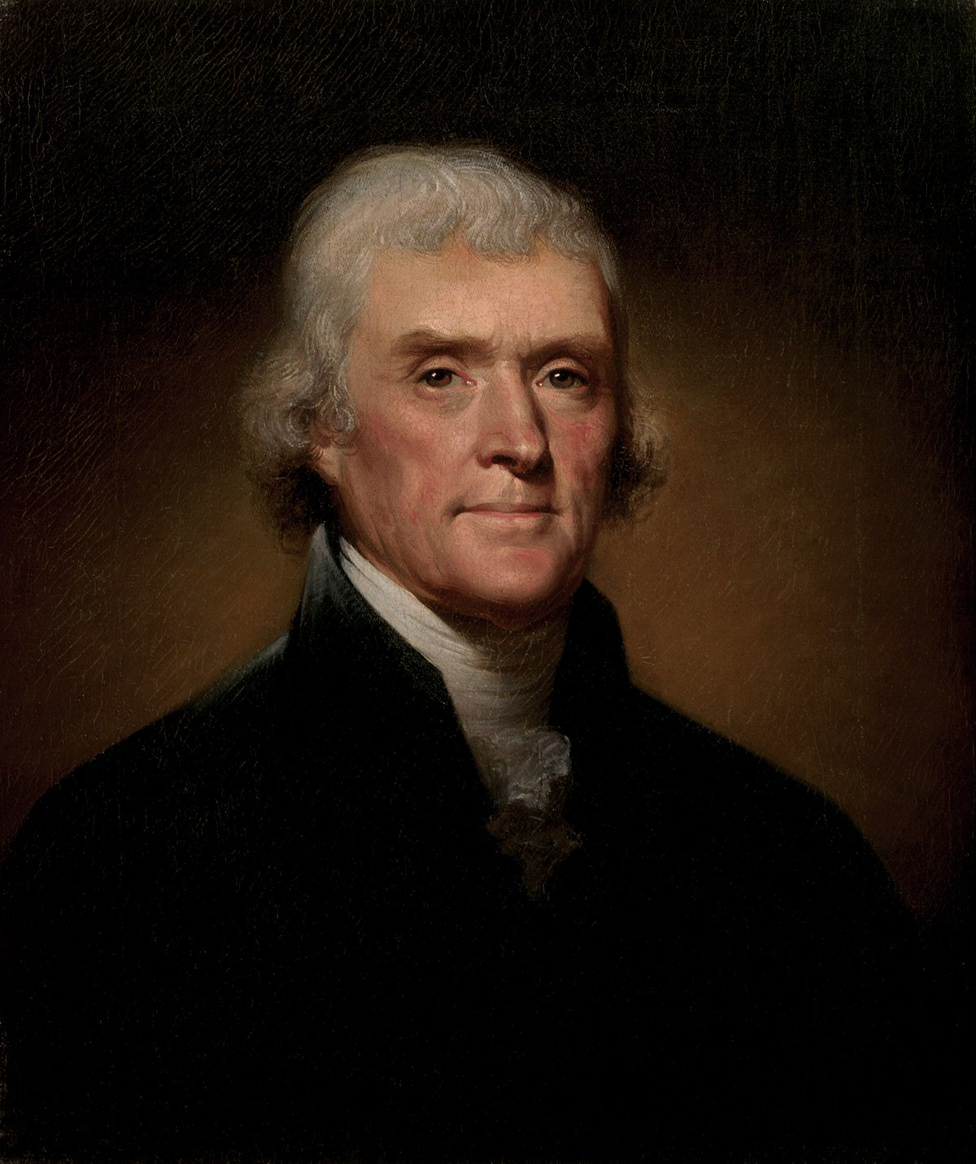
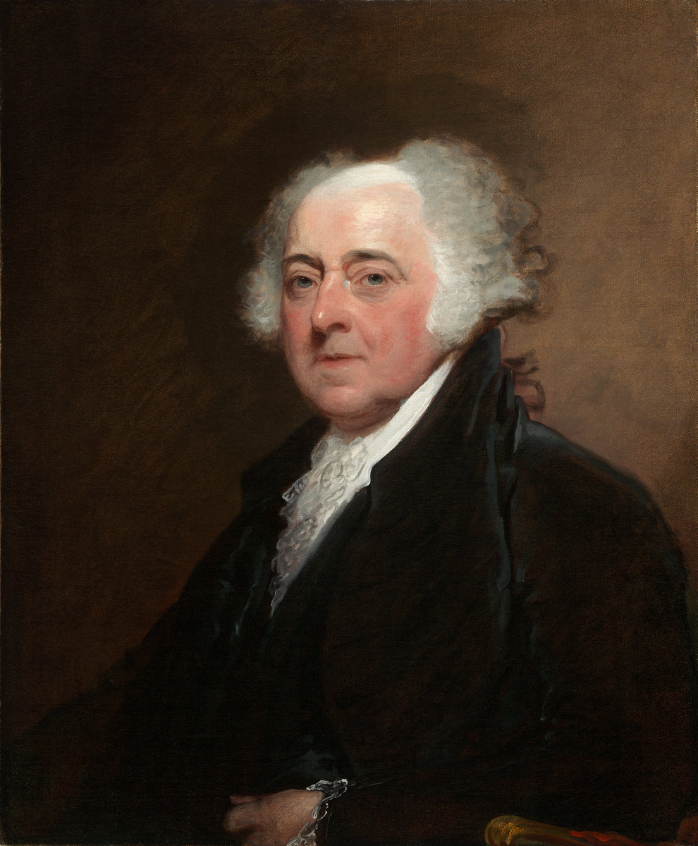
ideas
Thomas Jefferson John Adams
Notes:
Our founding fathers, Jefferson and Adam, famously were in disagreement on many things
But they did agree that all American’s should be educated.
It would be a half a century after the declaration of independence
before we started to define public education,
over 80 years before we defined public higher education.

Slide 24
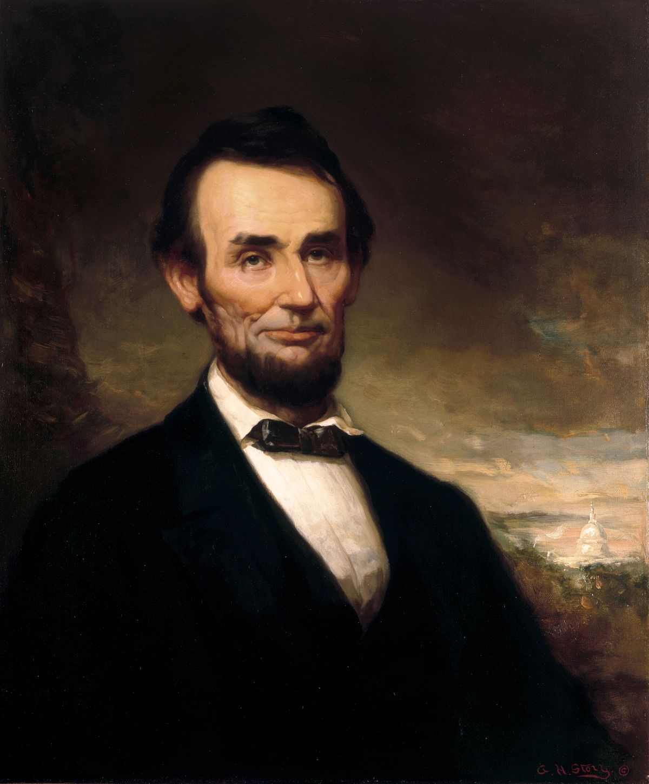
The Land Grant University System
ideas on post primary and secondary agricultural and mechanical ~~vocational education
1837 - Jonathan Baldwin Turner
1851 - Granville Convention
1852 – New Plan
1853 – More Plans in Illinois
1857 – 1859 – Morrill Act, vetoed
1862 – Abraham Lincoln ‘got it done!!’
Morrill Act of 1862
Notes:
While Horace Mann was developing a system of public education in the east
Jonathan Baldwin Turner was in the Midwest contemplating how to create a system of practical, mechanical, and agricultural education for the common man.
Turner’s ideas began to take hold, eventually contributing to the ideas in the Morrill Act of 1859.
The 1859 act was vetoed by President Buchanan in a show of support for the slave states, arguing a case of infringement upon the states by the federal government.
President Lincoln saw a new role for America, one that embraced a modern future that provided opportunities for the common man, opportunities for people to advance their own and the national interest through education in the agricultural and technological arts.

Slide 25
The Land Grant University System
ideas on post primary and secondary agricultural and mechanical vocational education
Morrill Act 1862 the establishment of cooperative land-grant universities
Hatch Act 1887 the establishment of cooperative agricultural experiment station system
Morrill Act 1890 the establishment cooperative industrial education fund
Adams Act 1906 the expansion of agricultural experiment station system
Social Contract With the People
Notes:
It was not a top-down imposition of federal power,
But a cooperative program, a partnership between the federal and state governments and the people

Slide 26
The Land Grant University System
ideas on post primary and secondary agricultural and mechanical vocational education
Morrill Act 1862 the establishment of cooperative land-grant universities
Hatch Act 1887 the establishment of cooperative agricultural experiment station system
Morrill Act 1890 the establishment cooperative industrial education fund
Adams Act 1906 the expansion of agricultural experiment station system
Social Contract With the People
Notes:
No longer were universities viewed as training grounds for the elite.
These new public universities had a mission to serve their society.
The new universities are accountable to the people they serve.

Slide 27
The Land Grant University System
ideas on post primary and secondary agricultural and mechanical vocational education
Morrill Act 1862 the establishment of cooperative land-grant universities
Hatch Act 1887 the establishment of cooperative agricultural experiment station system
Morrill Act 1890 the establishment cooperative industrial education fund
Adams Act 1906 the expansion of agricultural experiment station system
Social Contract With the People
Organized a System of Higher Education in America
Notes:
The act induced a system of public university education where none had broadly been before.

Slide 28
The Land Grant University System
ideas on post primary and secondary agricultural and mechanical vocational education
Morrill Act 1862 the establishment of cooperative land-grant universities
Hatch Act 1887 the establishment of cooperative agricultural experiment station system
Morrill Act 1890 the establishment cooperative industrial education fund
Adams Act 1906 the expansion of agricultural experiment station system
Social Contract With the People
Organized a System of Higher Education in America
Notes:
Upon the foundation of the Morrill Act,
The contract with the American people was extended
Establishing cooperative agricultural experiment stations
Cooperative – voluntary, not federally mandated

Slide 29
The Land Grant University System
ideas on post primary and secondary agricultural and mechanical vocational education
Morrill Act 1862 the establishment of cooperative land-grant universities
Hatch Act 1887 the establishment of cooperative agricultural experiment station system
Morrill Act 1890 the establishment cooperative industrial education fund
Adams Act 1906 the expansion of agricultural experiment station system
Social Contract With the People
Organized a System of Higher Education in America
Notes:
Extended once more with the establishment
of a cooperative system of industrial education
Cooperative – voluntary, not federally mandated

Slide 30
The Land Grant University System
ideas on post primary and secondary agricultural and mechanical vocational education
Morrill Act 1862 the establishment of cooperative land-grant universities
Hatch Act 1887 the establishment of cooperative agricultural experiment station system
Morrill Act 1890 the establishment cooperative industrial education fund
Adams Act 1906 the expansion of agricultural experiment station system
Social Contract With the People
Organized a System of Higher Education in America
Notes:
Extended once more with the expansion of the experiment stations.

Slide 31
Many Years Later
Congress
education for the people
science, technology, engineering, math - training workforce
economic development – increasing prosperity – reducing poverty
the standing of America on the world stage
national security threats – strength of the U.S. versus foreign powers
military technology and preparedness
Notes:
Many years later
The Congress was intensely discussing the dynamics of the changing world
The modern stem economy
Problems in workforce development
Issues in education
Our standing on the world stage
Our ability to control our destiny and protect our country.

Slide 32
Many Years Later
Congress
education for the people
science, technology, engineering, math - training workforce
economic development – increasing prosperity – reducing poverty
the standing of America on the world stage
national security threats – strength of the U.S. versus foreign powers
military technology and preparedness
50+ years after the Morrill Act
hand-wringing discussions about secondary education
The Year was 1916
Notes:
The Year was 1916

Slide 33
The Secondary Education ‘Vocational’ System
ideas on secondary agricultural and mechanical vocational education
Smith-Hughes Act of 1917 the establishment of cooperative vocational education for secondary education
ROTC in land-grant universities, & vocational training within the military
Vocational Education Act of 1963 – Amended in 1968
Perkins Acts’ of 1984, 1998, 2000, 2006, 2018
Now CTE, Career & Technology Education
Social Contract With the People
Notes:
In 1917, congress passed the smith-hughes act of 1917
Providing for the establishment of cooperative vocational education for secondary education
This was not an imposition of federal power on the states. Participation was voluntary.

Slide 34
The Secondary Education ‘Vocational’ System
ideas on secondary agricultural and mechanical vocational education
Smith-Hughes Act of 1917 the establishment of cooperative vocational education for secondary education
ROTC in land-grant universities, & vocational training within the military
Vocational Education Act of 1963 – Amended in 1968
Perkins Acts’ of 1984, 1998, 2000, 2006, 2018
Now CTE, Career & Technology Education
Social Contract With the People
Notes:
A careful reading of the debates in 1916 reveals a focus and intensity of how important education is to the national interest.
The recognition by the Congress for a national program of education for what we now call skilled technical workforce, career and technical education, for STEM education led to much more than the Smith-Hughes vocation act.
The debates led to the creation of the ROTC, reserve officer training corp, housed at the land grant universities, as a way to establish a national system of guard and reserves in lieu of a large standing army and in lieu of a military academy in ever state.
The military changed methods, using a system of vocational education within the military to give soldiers necessary skills for the national defense, and a set of skill to take back home.
When you see a recruitment advertisement for the military today that talks about the skills you can learn and take home, that system was a result of the 1916 debates. ROTC was a result of those debates, along with the smith-hughes vocational act.

Slide 35
The Secondary Education ‘Vocational’ System
ideas on secondary agricultural and mechanical vocational education
Smith-Hughes Act of 1917 the establishment of cooperative vocational education for secondary education
ROTC in land-grant universities, & vocational training within the military
Vocational Education Act of 1963 – Amended in 1968
Perkins Acts’ of 1984, 1998, 2000, 2006, 2018
Now CTE, Career & Technology Education
Notes:
Smith-Hughes was updated and replaced by the vocation education act

Slide 36
The Secondary Education ‘Vocational’ System
ideas on secondary agricultural and mechanical vocational education
Smith-Hughes Act of 1917 the establishment of cooperative vocational education for secondary education
ROTC in land-grant universities, & vocational training within the military
Vocational Education Act of 1963 – Amended in 1968
Perkins Acts’ of 1984, 1998, 2000, 2006, 2018
Now CTE, Career & Technology Education
Notes:
And evolved into the Perkin’s system for federal grants to the states

Slide 37
The Secondary Education ‘Vocational’ System
ideas on secondary agricultural and mechanical vocational education
Smith-Hughes Act of 1917 the establishment of cooperative vocational education for secondary education
ROTC in land-grant universities, & vocational training within the military
Vocational Education Act of 1963 – Amended in 1968
Perkins Acts’ of 1984, 1998, 2000, 2006, 2018
Now CTE, Career & Technology Education
Notes:
The original system for vocation educational education
Has evolved and modernized for todays economy.

Slide 38
The Bifurcation of Education
The Academy vs. The Vocational - CTE
Notes:
The current CTE system is continuing to have positive impact on our economy.
There is a side effect of the original legislation that we have to work around.
That is the bifurcation or splitting of secondary education into two siloes or systems.
The major impact is on how we do, and do not develop new teachers.

Slide 39
Education
Academic Education
Math & Science
Reading & Writing
Humanities
Career & Technical Education
Architecture and Construction
Science, Technology, Engineering, Mathematics
Engineering & Technology
Engineering Design
Electronics
Arts, AV/Technology, and Communications
Business, Management, and Administration
Finance
Government and Public Administration
Health Science
Information Technology
Cybersecurity
Game Design
Internet of Things
Programming
Web Development
Computer Science
IT Support & Services
Networking
Web & Digital Design
​Agriculture, Food, and Natural Resources
Law, Public Safety, Corrections, and Security
Marketing
Transportation, Distribution, and Logistics
Education and Training
Advanced Manufacturing
Manufacturing
Mechatronics
​Industrial Maintenance
Hospitality and Tourism
Energy
Energy Systems
Energy & Power
Informal Learning
Museums
Science Fairs
Robotics
Notes:
In the beginning,
There was education

Slide 40
Education
Academic Education
Math & Science
Reading & Writing
Humanities
Career & Technical Education
Architecture and Construction
Science, Technology, Engineering, Mathematics
Engineering & Technology
Engineering Design
Electronics
Arts, AV/Technology, and Communications
Business, Management, and Administration
Finance
Government and Public Administration
Health Science
Information Technology
Cybersecurity
Game Design
Internet of Things
Programming
Web Development
Computer Science
IT Support & Services
Networking
Web & Digital Design
​Agriculture, Food, and Natural Resources
Law, Public Safety, Corrections, and Security
Marketing
Transportation, Distribution, and Logistics
Education and Training
Advanced Manufacturing
Manufacturing
Mechatronics
​Industrial Maintenance
Hospitality and Tourism
Energy
Energy Systems
Energy & Power
Informal Learning
Museums
Science Fairs
Robotics
Notes:
Early education was principally ‘academic’
Reading
Writing
Arithmetic

Slide 41
Education
Academic Education
Math & Science
Reading & Writing
Humanities
Career & Technical Education
Architecture and Construction
Science, Technology, Engineering, Mathematics
Engineering & Technology
Engineering Design
Electronics
Arts, AV/Technology, and Communications
Business, Management, and Administration
Finance
Government and Public Administration
Health Science
Information Technology
Cybersecurity
Game Design
Internet of Things
Programming
Web Development
Computer Science
IT Support & Services
Networking
Web & Digital Design
​Agriculture, Food, and Natural Resources
Law, Public Safety, Corrections, and Security
Marketing
Transportation, Distribution, and Logistics
Education and Training
Advanced Manufacturing
Manufacturing
Mechatronics
​Industrial Maintenance
Hospitality and Tourism
Energy
Energy Systems
Energy & Power
Informal Learning
Museums
Science Fairs
Robotics
Notes:
For completeness, I have added informal learning,
Or the type of learning that you get outside of the classroom

Slide 42
Education
Academic Education
Math & Science
Reading & Writing
Humanities
Vocational Education
Architecture and Construction
Science, Technology, Engineering, Mathematics
Engineering & Technology
Engineering Design
Electronics
Arts, AV/Technology, and Communications
Business, Management, and Administration
Finance
Government and Public Administration
Health Science
Information Technology
Cybersecurity
Game Design
Internet of Things
Programming
Web Development
Computer Science
IT Support & Services
Networking
Web & Digital Design
​Agriculture, Food, and Natural Resources
Law, Public Safety, Corrections, and Security
Marketing
Transportation, Distribution, and Logistics
Education and Training
Advanced Manufacturing
Manufacturing
Mechatronics
​Industrial Maintenance
Hospitality and Tourism
Energy
Energy Systems
Energy & Power
Informal Learning
Museums
Science Fairs
Robotics
Agricultural
Trades
Industrial
Homemaking
Notes:
When the smith hughes act was passed in 1917
Students had an additional option, vocational education
Agriculture
The trades
Industrial education
Homemaking

Slide 43
Education
Academic Education
Math & Science
Reading & Writing
Humanities
Career & Technical Education
Architecture and Construction
Science, Technology, Engineering, Mathematics
Engineering & Technology
Engineering Design
Electronics
Arts, AV/Technology, and Communications
Business, Management, and Administration
Finance
Government and Public Administration
Health Science
Information Technology
Cybersecurity
Game Design
Internet of Things
Programming
Web Development
Computer Science
IT Support & Services
Networking
Web & Digital Design
​Agriculture, Food, and Natural Resources
Law, Public Safety, Corrections, and Security
Marketing
Transportation, Distribution, and Logistics
Education and Training
Advanced Manufacturing
Manufacturing
Mechatronics
​Industrial Maintenance
Hospitality and Tourism
Energy
Energy Systems
Energy & Power
Informal Learning
Museums
Science Fairs
Robotics
17 Career Clusters
Notes:
Vocational education is now called career and technical education
The original four topics are now located within 17 career clusters
Each cluster splitting off into multiple specialities.

Slide 44
Education
Academic Education
Math & Science
Reading & Writing
Humanities
Career & Technical Education
Architecture and Construction
Science, Technology, Engineering, Mathematics
Engineering & Technology
Engineering Design
Electronics
Arts, AV/Technology, and Communications
Business, Management, and Administration
Finance
Government and Public Administration
Health Science
Information Technology
Cybersecurity
Game Design
Internet of Things
Programming
Web Development
Computer Science
IT Support & Services
Networking
Web & Digital Design
​Agriculture, Food, and Natural Resources
Law, Public Safety, Corrections, and Security
Marketing
Transportation, Distribution, and Logistics
Education and Training
Advanced Manufacturing
Manufacturing
Mechatronics
​Industrial Maintenance
Hospitality and Tourism
Energy
Energy Systems
Energy & Power
Informal Learning
Museums
Science Fairs
Robotics
“STEM”
Health
Science
Computer
Science & IT
17 Career Clusters
Advanced
Manufacturing
Energy
Notes:
The STEM cluster is where the engineering and architectural pieces are.
The information technology cluster contains computer science and information technology.
Shop class became advanced manufacturing
The biosciences live in the health science cluster alongside healthcare.
The education world we need to work in looks much different than in 1917.

Slide 45
Education
Academic Education
Math & Science
Reading & Writing
Humanities
Career & Technical Education
Architecture and Construction
Science, Technology, Engineering, Mathematics
Engineering & Technology
Engineering Design
Electronics
Arts, AV/Technology, and Communications
Business, Management, and Administration
Finance
Government and Public Administration
Health Science
Information Technology
Cybersecurity
Game Design
Internet of Things
Programming
Web Development
Computer Science
IT Support & Services
Networking
Web & Digital Design
​Agriculture, Food, and Natural Resources
Law, Public Safety, Corrections, and Security
Marketing
Transportation, Distribution, and Logistics
Education and Training
Advanced Manufacturing
Manufacturing
Mechatronics
​Industrial Maintenance
Hospitality and Tourism
Energy
Energy Systems
Energy & Power
Informal Learning
Museums
Science Fairs
Robotics
“STEM”
Health
Science
Computer
Science & IT
17 Career Clusters
Advanced
Manufacturing
Energy
Notes:
Today, the principal focus of the colleges of education and our teacher development systems live inside of the red circle.
There are several reasons for this, including the bifurcation of 1917.

Slide 46
Key Findings & Notes
Currently, Teacher Development is Everyone’s Business
Therefore……… it is No One’s Business
Structural Failure In Our Ability Create Teachers in our Dynamic Economy
How Do We Fix This
and respect our values in governance and local control in education ?
The Good News
Same class of problem that was faced in 1862 by Lincoln, and 1916 by Wilson.
The Bad News
Past Attempts. Failure To Craft a More Optimal Solution. Incorrect Problem Framing.
Uncorrected, the Potential To Be a National Catastrophe.
Notes:
After some eight years of investigation, I have come to some key conclusions.
( the slide )

Slide 47
THE Key Finding
On the Current Trajectory
There is little to no chance that
we will solve this problem within the next 100 years
Negatively Impacting Everything:
national and economic security
general welfare of our citizens
ability to provide educational equity to disenfranchised students.
Notes:
After some eight years of investigation, I have come to some key conclusions.
( the slide )

Slide 48
THE Key Finding
On the Current Trajectory
There is little to no chance that
we will solve this problem within the next 100 years
Even Worse:
Shifting Labor Markets
Declining Enrollments in Colleges
Shrinking Pool of Human Capital for Teaching
Notes:
After some eight years of investigation, I have come to some key conclusions.
( the slide )

Slide 49
THE Key Finding
On the Current Trajectory
There is little to no chance that
we will solve this problem within the next 100 years
Negatively Impacting Everything:
national and economic security
general welfare of our citizens
ability to provide educational equity to disenfranchised students
And the National Agenda – Infrastructure, Education, etc ……….
Notes:
After some eight years of investigation, I have come to some key conclusions.
( the slide )

Slide 50
ELEMENTARY GRADES EDUCATION
• MATH
• SCIENCE
SECONDARY GRADES ‘ACADEMIC’ EDUCATION
• MATH
• SCIENCE
• PHYSICS
• BIOLOGY
• CHEMISTRY
SECONDARY GRADES ‘CTE’ CAREER AND TECHNICAL EDUCATION
• ROBOTICS
• ENGINEERING
• ARCHITECTURE
• CYBERSECURITY
• BIOTECHNOLOGY
• COMPUTER SCIENCE
• ARTIFICIAL INTELLIGENCE
• INFORMATION TECHNOLOGY
• ADVANCED MANUFACTURING
High Demand Teacher Initiative
SECONDARY GRADES
HIGH SCHOOLS
COLLEGE & CAREER ACADEMIES
TECH HIGH SCHOOLS
TECHNICAL COLLEGES
Notes:
The purpose of this briefing is to present a proposal for teachers for the 21st century economy.
From this point on, I will use the word ‘teacher’ to refer solely to those that teach in these fields.
STEM, science, technology, engineering, and math
Career and Technical Education, or CTE
And STW, or Skilled Technical Workforce
The major emphasis is on the secondary grades, high schools, college and career academies, technical high schools, and technical colleges.

Slide 51
Key Factors Used in Formulating a Solution
High Demand Teacher Initiative
# 1 Align the Needs of Candidates, Universities, and Schools
Not the Case at Present, hence the failure.
# 2 University Colleges of Education Undergraduate Programs will NOT
Be capable of resolving the STEM/ CTE / STW teacher supply issue
in a statistically meaningful way, too many structural difficulties
# 3 The Locus of Decision is located with the Teacher Candidate
# 4 There Are Technically Qualified Teacher Candidates Immediately Available
That Do Not Enter Teaching Because of The Barriers to Entry
# 5 Follow Prior Successful Examples - Cooperative Acts to Advance National Priorities
Morrell Act of 1862
Smith-Hughes Act of 1917
Notes:
(slide)

Slide 52
Landmark Acts of Congress
Legislative Model
Morrill Act 1862 A Coherent System of Universities
Smith-Hughes Act of 1917 A Coherent System of Secondary Education
High Demand Teacher Initiative Will Create a Coherent System
of STEM/CTE/STW Teacher Development
Because of How It Will Organize the Pipeline
Notes:
The original system for vocation educational education
Has evolved and modernized for todays economy.

Slide 53
Landmark Acts of Congress
Legislative Model
Morrill Act 1862 A Coherent System of Universities
Smith-Hughes Act of 1917 A Coherent System of Secondary Education
High Demand Teacher Initiative Will Create a Coherent System
of STEM/CTE/STW Teacher Development
Because of How It Will Organize the Pipeline
Notes:
The original system for vocation educational education
Has evolved and modernized for todays economy.

Slide 54
Landmark Acts of Congress
Legislative Model
Morrill Act 1862 A Coherent System of Universities
Smith-Hughes Act of 1917 A Coherent System of Secondary Education
High Demand Teacher Initiative Will Create a Coherent System
of STEM/CTE/STW Teacher Development
Because of How It Will Organize the Pipeline
Notes:
The original system for vocation educational education
Has evolved and modernized for todays economy.

Slide 55
Landmark Acts of Congress
Legislative Model
Morrill Act 1862 A Coherent System of Universities
Smith-Hughes Act of 1917 A Coherent System of Secondary Education
High Demand Teacher Initiative Will Create a Coherent System
of STEM/CTE/STW Teacher Development
Because of How It Will Organize the Pipeline
Notes:
The original system for vocation educational education
Has evolved and modernized for todays economy.

Slide 56
Landmark Acts of Congress
Legislative Model
Morrill Act 1862 A Coherent System of Universities
Smith-Hughes Act of 1917 A Coherent System of Secondary Education
High Demand Teacher Initiative Will Create a Coherent System
of STEM/CTE/STW Teacher Development
Because of How It Will Organize the Pipeline
Notes:
The original system for vocation educational education
Has evolved and modernized for todays economy.

Slide 57
High Demand Teacher Initiative
Direct Payment
Similar to the
Federal Pell Grant
Institution on behalf
of the Candidate
Federal Grant ( Scholarship )

Slide 58
High Demand Teacher Initiative
Direct Payment
Similar to the
Federal Pell Grant
Institution on behalf
of the Candidate
Federal Grant ( Scholarship )
$ 200 M / year
10,000 new teachers / year
$ 20,000 lifetime maximum

Slide 59
High Demand Teacher Initiative
Direct Payment
Similar to the
Federal Pell Grant
Institution on behalf
of the Candidate
Federal Grant ( Scholarship )
$ 200 M / year
10,000 new teachers / year
$ 20,000 lifetime maximum
All of This, For the Price of Two Passenger Jet Airliners

Slide 60
IHE Based Qualifying Candidates
BS or Higher Degree in one of the following Fields
Chemistry
Computer Science
Biochemistry
Biotechnology
Biology
Physics
Engineering
Engineering Science
Engineering Technology
Engineering Science
Environmental Science
Mathematics
Material Science
Or certain integrative STEM/CS degrees
IHE – Institution of Higher Education

Slide 61
Non-IHE Based Qualifying Candidates
Candidates must be sponsored by a local school district or educational authority, having received an offer for full time employment in a CTE or STW field of STEM, Health Science, Information Technology, Advanced Manufacturing, or Energy Career Cluster as defined by the National Career Clusters Framework.

Slide 62
Concurrent Candidates
Employed as a full-time teacher
While earning the teaching credential
The grant is effectively a form of compensation
Non-Concurrent Candidates
Earn the teaching credential
Starts teaching after earning the credential
The grant is converted into a loan

Slide 63
Why Not Develop Undergraduate Programs in the Universities ?
Breadth And Depth Of Topics
Difficult To Impossible To Replicate The Knowledge Within the College of Engineering
Capital Costs Of Facilities
Insufficient Cohort Size
Limited Subset Of Universities With The Critical Mass To Undertake A Large-scale Program
Uncertainty Of The Student Completing The Teaching Degree Program
Diminished Prospects For The Student If They Leave Teaching But Want To Stay In The STEM/CTE Field.

Slide 64
Advantages of existing degree holders going into teaching, Graduate Programs
The Candidate Is Known Quantity
If The Candidate Leaves Teaching, They Can Fully Re-enter The STEM / CTE / STW Workforce
No Labs To Build
No Facilities To Build
The Burden Of Technical Knowledge Comes From The Candidates Degree
The Burden On The College Of Education Is Primarily Limited To Pedagological Training
There Are Many Universities That Have Implemented a Pedagogy Only Masters Program
In Place, and Ready To Go

Slide 65
Advantages of existing degree holders going into teaching, Graduate Programs
The Candidate Is Known Quantity
If The Candidate Leaves Teaching, They Can Fully Re-enter The STEM / CTE / STW Workforce
The Technical Training Of The Candidate Was Symbiotic With The Base Degree
No Labs To Build
No Facilities To Build
The Burden Of Technical Knowledge Comes From The Candidates Degree
The Burden On The College Of Education Is Primarily Limited To Pedogeological Training
There Are Many Universities That Have Implemented a Pedagogy Only Masters Program
In Place, and Ready To Go
The Key Decision Maker is The Candidate

